Slide 1
The distribution grid
Carcano & Cividini
V A/AUTOMAZIONE
Anno 2015/2016

Slide 2
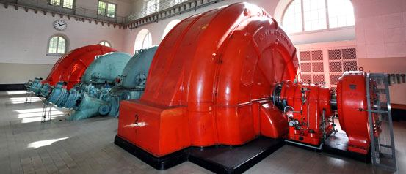
Generator
Generator produces alternating current at high voltage, usually 25.000 V.
It produces alternating current because it is easier to boost the voltage of alternating current than direct current.
However, if the current is transmitted at a high voltage, less current is needed to transmit the same amount of electric power, so there is fewer waste of current.

Slide 3
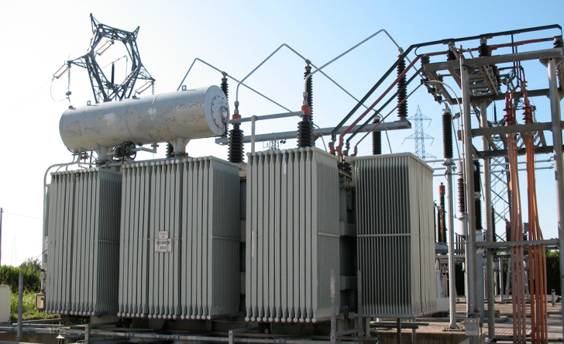
Transformer and substation
Step-up transformer boosts a voltage so high as 400.000 V.
It permits to transmit the current across the country.
The substation, known as step-down transformer, reduces the high voltage to levels suitable for different types of consumers.

Slide 4
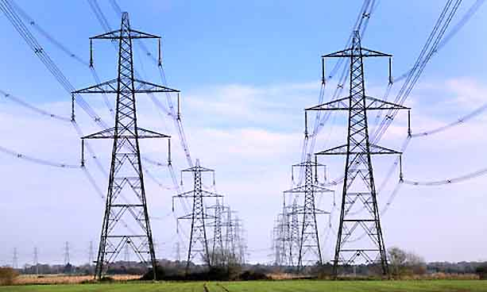
Pylon
The pylon supports overhead wires, called ‘’trasmission lines’’, which carry the current across the country.
In the city there are not any pylons because underground cables are used.
Out of the cities there are overhead wires, because underground cables are more expensive.

Slide 5
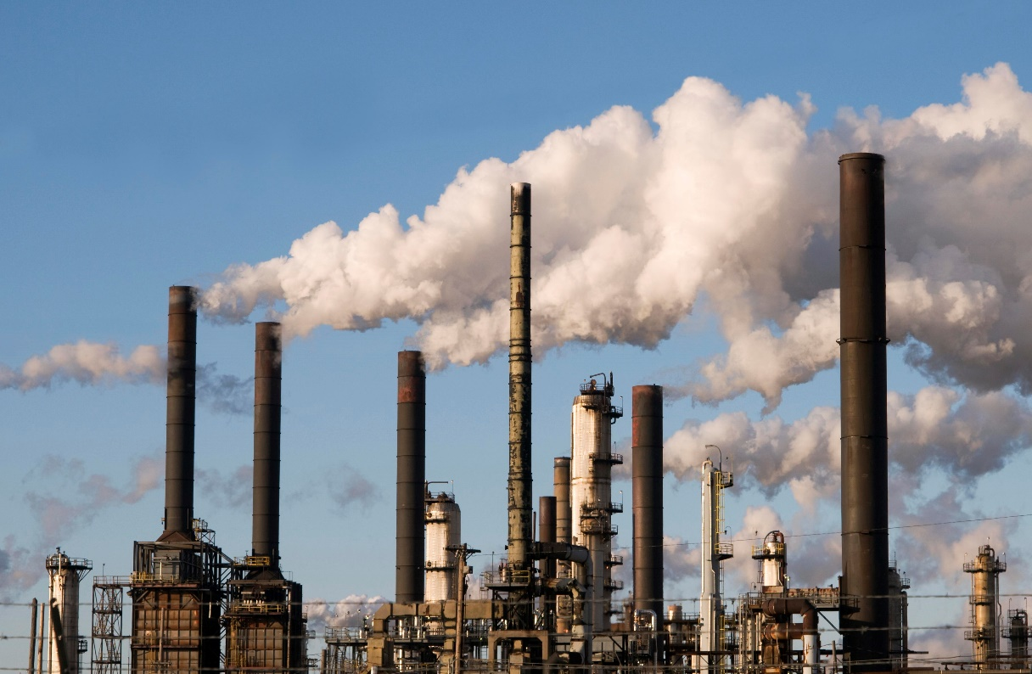
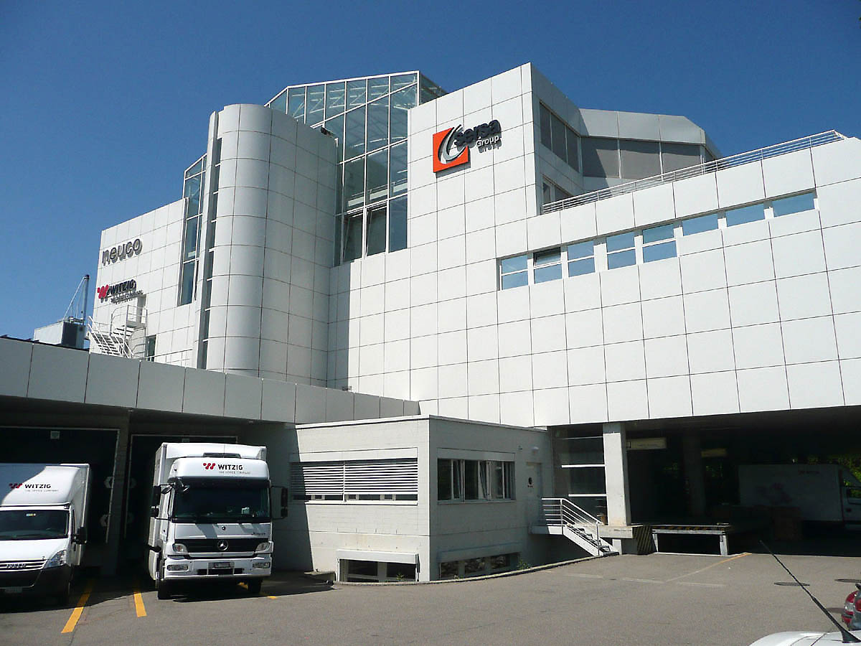
Heavy and light industry
The biggest consumers of electricity are industries.
There are two different types: heavy industry and light industry.
The first one requires a high voltage of 33.000 V; the second one requires 11.000 V.

Slide 6
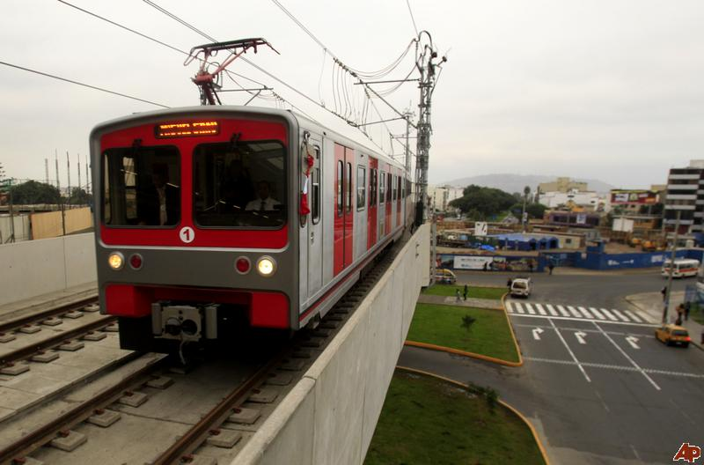
Electric train
Other consumers of electricity at high voltage are electric trains.
Electric trains run on 25.000 V.
Other means of transport that work at the same voltage as the electric train are:
- Electric locomotive
- Railway electrification system
- Tram

Slide 7
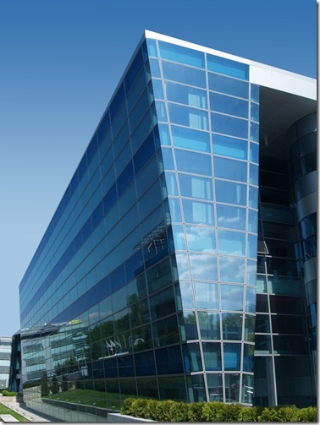
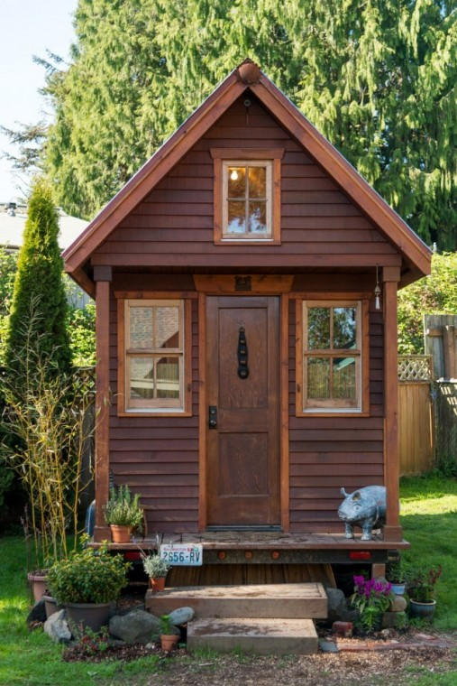
Houses and offices
The high voltage would be too dangerous for people living in houses and working in offices.
In fact, the voltage is usually reduced to 120V for houses and 240V for offices.

