Slide 1
APPEARANCE
LOOKS | BODY |  | HAIR
 | Height | Build | Lenght | Type | Colour
Ugly | Tall | Thin | Long | Wavy | Dark
Pretty | Short | Slim | Short | Curly | Blonde
Good-looking | Of averege height | Stocky | Shoulder- length | Straight | Fair
Attractive |  | Well -built
Handsome |  | Fat
Beautifull |  | Skinny
Gorgeus |  | Plump
Middle-aged |  | Chubby
Old
Young

Slide 2
Physical description what do you look like? what does he look like?
ES/ i’M tall and slim…
I look like my mum (Assomiglio a mia mamma)
PERSONALITY WHAT ARE YOU LIKE?
WHAT IS HE LIKE?
ES/ I’M FUNNY/BORING…
HE’S SHY

Slide 3
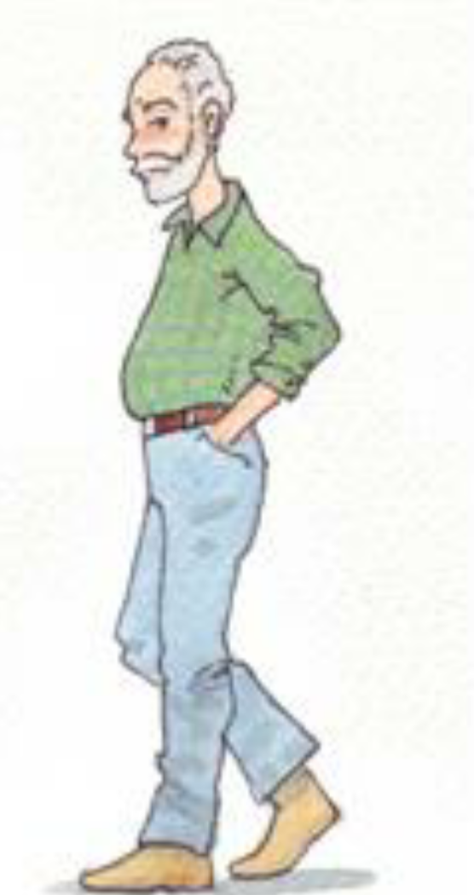
This is an old man. He’s tall and fat. He has got short, curly, grey hair. He has got black eyes.
PHYSICAL DESCRIPTION

Slide 4
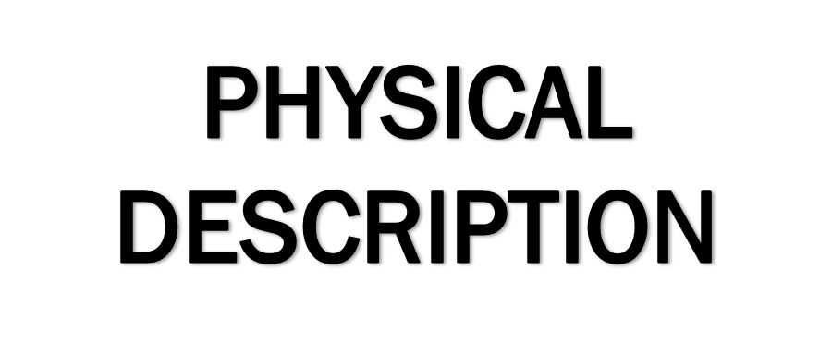
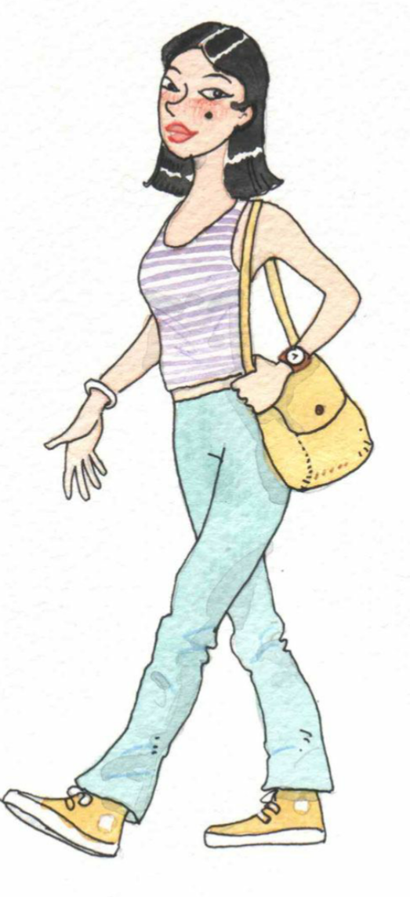
This is young and beautifull girl. She’s tall and slim. She has got shoulder-length, straight, black hair. She has got black eyes.

Slide 5
Work done by : cristian frison luca gamba davide agostini filippo basilico joseph anzalone simone sgambato

